Slide 1
23075 IoT6
Simplifying TCP/IP Applications with MPLAB® Harmony

Slide 2
Class Objectives
When you walk out of this class you will be able to…
Understand the fundamentals of TCP/IP and how applications use them to create TCP/IP connections.
Understanding Network analysis with the well-known tool Wireshark
Learn the architecture and the fundamentals of the Harmony TCP/IP stack to interface your application with some common stack API's in a FreeRTOS Task Schedular enviroment

Slide 3
Agenda – Lecture
Part 1: TCP/IP Fundamentals as a Refresher
Part 2: MPLAB® Harmony TCP/IP Stack Overview
TCP/IP Layers and Features
Network Interface Options
Processor Requirements
Part 3: Using the MPLAB® Harmony TCP/IP Stack
Creating a new project, stack configuration and connectivity check (Lab 1)
MPLAB® Harmony TCP/IP Stack APIs
Application integration for local access, using the example of a Vending machine (Lab 2)
Application integration for external access using the example of a Weather Service (Lab 3)

Slide 4
Agenda – Labs
Lab 1: Creating a new project, Stack Configuration and Connectivity Check
Lab 2: Application integration for local access, using the example of a Vending machine
Lab 3: Application integration for external access, using the example of a Weather Service

Slide 5
Part 1: TCP/IP Fundamentals as a Refresher
Five Layer Model and Applications
TCP vs UDP

Slide 6
Agenda Five Layer Model and Applications
Five Layer Software Model
Application Layer
Transport Layer
Network Layer
Data Link Layer
Physical Layer
TCP vs. UDP
TCP/IP Applications
DNS, NBNS, SNTP, DHCP, SNMP, Telnet, SMTP, HTTP
Network Host
Application Layer
Transport Layer (TCP/UDP)
Network Layer (IP)
Data Link Layer (MAC)
Physical Layer
Notes:
In this training class you will learn about the 5 layer TCP/IP software model. We’ll start at the Application layer and work our way down through the Transport, Network, Data Link, and Physical Layers.
<click>
When we get to the Transport layer, we will discuss the differences between TCP and UDP and explain why specific applications use one instead of the other.
<click>
Last we will briefly describe each of the common TCP/IP applications shown.
We will also ask you some questions during the class to test your knowledge and help reinforce what you’ve learned.

Slide 7
Basic Needs for TCP/IP Transmissions
Need to Specify:
Most reliable or fastest transmissions
Where we want the data delivered
Needs to be sent with all transmitted data.
Network Host A
Network Host B
Move data across a network
Application X
Application Y
Also need to physically transmit the data
Notes:
Script:
Some of the applications we use require us to move data from point a to point b across a network. The TCP/IP network provides a framework for transmitting this data, and it requires some basic information from us to move this data.
<click>
We need to specify if we want the most reliable or fastest transmissions
<click>
We need to specify where we want the data delivered. Sometimes our data is routed based on its IP address and sometimes its routed based on its MAC address. The data we send needs both addressing capabilities
<click>
This information needs to be sent along with all transmitted data.
<click>
We also need to physically transmit the data from one location to another.

Slide 8
TCP/IP 5 Layer Model
Each layer performs a specific task needed to move our data across the network
Each layer only communicates with adjacent layers
Network Host
Layer 5 requests connections to remote hosts
Application Layer
Transport Layer (TCP/UDP)
Network Layer (IP)
Data Link Layer (MAC)
Layer 1 encodes and transmits bits
Physical Layer
Notes:
Script:
We need to provide this basic information needed by TCP/IP in a standard format the network can understand. This format is provided by its 5 layer software model.
<click>
Each layer provides TCP/IP with the basic information it needs to move our data across the network. These layers group functions according to the task that needs to be performed. Every function in this model is targeted to help a specific layer perform its job.
<click>
Each layer only communicates with adjacent layers. Software running in a higher layer does not have to know about or perform tasks delegated to lower layer functions and vise versa. For example, the software you write for your application
<click>
only needs to know how to request a connection with a remote host using the transport layer.
<click>
It doesn’t need to know how bits are encoded before transmission. That’s the Physical layer’s job.
Other slide info:
You have probably all heard of the 7 layer OSI model. TCP/IP simplifies this model to 5 layers. OSI stands for Open Systems Interconnect which is a standard communication systems model. The top 4 layers of the 7 layer OSI model have been condensed into the top two TCP/IP layers.

Slide 9
What Does Each Layer Do?
Application Layer
Host A
Generates the data and requests connections
Host B
The Application layer is the group of applications requiring network communications.
Web Browser
Web Server
Transport Layer (TCP/UDP)
Establishes connections with remote host
The Transport layer establishes the connection between applications on different hosts.
Network Layer (IP)
Transfers packets with virtual (IP) addresses
The Network layer is responsible for creating the packets that move across the network.
Data Link Layer (MAC)
Transfers frames with physical (MAC) addresses
The Data Link layer is responsible for creating the frames that move across the network.
Physical Layer
Transmits and receives bits
The Physical layer is the transceiver that drives
the signals on the network.
Notes:
Script:
Before we discuss each layer, let’s briefly summarize what each layer does.
<click>
As you might have guessed, the application layer is where applications requiring network communications live. Examples of these applications include email clients and web browsers. These applications use the transport layer to send requests to connect to remote hosts.
<click>
The Transport layer establishes the connection between applications running on different hosts. It uses TCP for reliable connections and UDP for fast connections. It keeps track of the processes running in the applications above it by assigning port numbers to them and uses the Network layer to access the TCP/IP network.
<click>
The Network layer is responsible for creating the packets that move across the network. It uses IP addresses to identify the packet’s source and destination.
<click>
The Data Link layer is responsible for creating the frames that move across the network. These frames encapsulate the packets and use MAC addresses to identify the source and destination.
<click>
The Physical layer encodes and decodes the bits found in a frame and includes the transceiver that drives and receives the signals on the network.

Slide 10
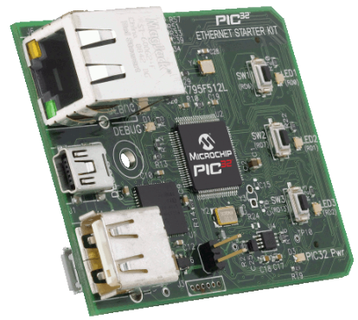
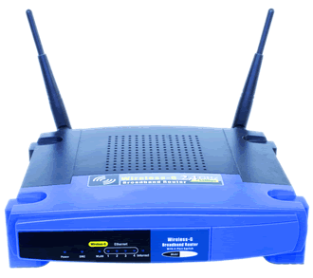
Application Layer (Layer 5)
Layer 5 is where TCP/IP applications live
Your application typically interacts with these applications
Network Host
NBNS
DNS
SNTP
DHCP
SNMP
TFTP
Telnet
SMTP
HTTP
UDP
TCP
IP
MAC
PHY
Notes:
Script:
The top layer or layer 5 is called the Application layer. This is where most TCP/IP applications live.
<click>
The software you generate for your end application will typically interact with some of these applications. The most commonly used TCP/IP application
<click>
is HTTP which is used for surfing the internet. We will discuss what each of these applications do later in this training.

Slide 11
Transport Layer (Layer 4)
Connects to remote hosts using either:
TCP (Transfer Control Protocol)
UDP (User Datagram protocol)
Delivers data to and from applications
Assigns port numbers to processes running in applications
Network Host
NBNS
DNS
SNTP
DHCP
SNMP
TFTP
Telnet
SMTP
HTTP
UDP
TCP
IP
MAC
PHY
Notes:
Script:
Layer 4 is the Transport layer.
<click>
The transport layer creates virtual TCP or UDP connections between network hosts. TCP stands for Transfer Control Protocol and UDP stands for User Datagram Protocol.
<click>
This layer sends and receives data to and from the applications running on its host.
<click>
The Transport layer will assign port numbers to the processes running in applications on the host, and will add a TCP or UDP header to the messages received from the applications detailing the source and destination port numbers.
Note that some of the applications, specifically Telnet, SMTP and HTTP require TCP as the transport protocol while the others use UDP. Let’s find out why an application would choose to use one vs the other.

Slide 12
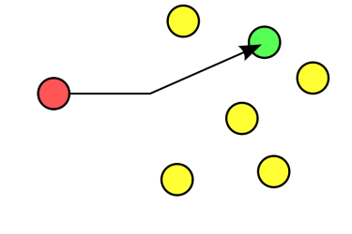
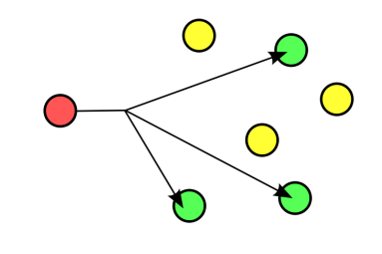
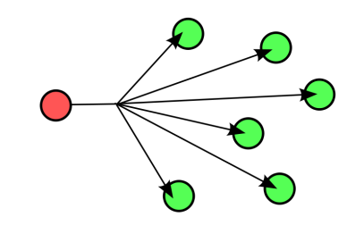
TCP vs. UDP
TCP
UDP
Slower but reliable transfers
Typical applications:
Email
Web browsing
Fast but non-guaranteed transfers (“best effort”)
Typical applications:
VoIP
Internet Radio
unicast
unicast
multicast
broadcast
Notes:
Script:
Some applications require reliable ordered delivery of packets. The TCP protocol provides this capability. It uses error detection, retransmissions and acknowledgements. This protocol cares about your data.
Other applications don’t care if every packet is received. These applications can take advantage UDP’s lower overhead to enable faster transmissions.
<click>
Typical TCP applications include email and web browsing
<click>
and typical UDP applications include VoIP and music streaming.
<click>
TCP is strictly used for point to point or unicast transmissions while UDP can also be used for multicast and broadcast transmissions.

Slide 13
TCP and UDP Header Formats Reference Slide
TCP Segment Header Format
Bit # | 0 7 |  |  | 8 15 | 16 23 | 24 31
0 | Source Port |  |  |  | Destination Port
32 | Sequence Number
64 | Acknowledgment Number
96 | Data Offset | Res | Flags |  | Window Size
128 | Header and Data Checksum |  |  |  | Urgent Pointer
160... | Options
UDP Datagram Header Format
Bit # | 0 7 | 8 15 | 16 23 | 24 31
0 | Source Port |  | Destination Port
32 | Length |  | Header and Data Checksum
Notes:
Script:
The header added to messages by the Transport layer includes more than just the source and destination port numbers. Here we are showing all the information included in TCP and UDP headers. I’m not going to spend time on the details of each field, but wanted to give you a sense of what kind of information is included in the headers. Note how the TCP protocol requires more information and overhead to guarantee data delivery.
Other slide info:
UDP adds source and destination port information to the messages, but not much more. The data checksum can be optionally used by the application layer.
TCP Segment Header structure complexity reflects the additional services offered:
Connection establishment and termination (“handshakes”)
Flow control
Acknowledgment and retransmission of packets (“sliding window”)
TCP uses checksum to ensure data delivered to application layer is error free.

Slide 14
Network Layer (Layer 3)
An IP address is 32 bits and looks like this: 192.168.1.101
Also known as the Internet layer
Adds a header to the data received from the transport layer
contains the source and destination IP addresses
Creates IP Packets
Network Host
NBNS
DNS
SNTP
DHCP
SNMP
TFTP
Telnet
SMTP
HTTP
UDP
TCP
IP
MAC
PHY
Notes:
Script:
Layer 3 is the Network or Internet layer.
<click>
When transmitting data, this layer adds a header containing the source and destination IP addresses to the to the data received from the Transport layer.
<click>
The Packet it creates will then be forwarded to the MAC or Data Link layer.
When receiving data, this layer is used to determine if the Packet received by the host contains the host’s IP address. If it does, the data is forwarded up to the Transport layer.
As a side note, routers are referred to as “layer 3” devices because they route packets based on their IP addresses.

Slide 15
IPv4 Packet Header Format (Reference Slide)
IPv4 Packet Header Format
Bit # | 0 7 |  | 8 15 |  | 16 23 |  | 24 31
0 | Version | IHL | DSCP | ECN | Total Length
32 | Identification |  |  |  | Flags | Fragment Offset
64 | Time to Live |  | Protocol |  | Header Checksum
96 | Source IP Address
128 | Destination IP Address
160 | Options (if IHL > 5)
Notes:
Script:
The Network layer header includes more than just the source and destination IP addresses. I’m not going to spend time on the details of each field, but wanted you to see all the other information that is included in the packet header.

Slide 16
Data Link Layer (Layer 2)
A MAC address is 48 bits and looks like this: F0:DE:F1:1E:E8:93
Uses a Media Access Controller to generate frames
Adds a header to the packet
Source and destination MAC addresses
Every host has at least one MAC address
Network Host
NBNS
DNS
SNTP
DHCP
SNMP
TFTP
Telnet
SMTP
HTTP
UDP
TCP
IP
MAC
PHY
Notes:
Script:
Layer 2 is the Data Link layer.
<click>
This layer uses a Media Access Controller or MAC to generate the frames that will be transmitted. As the name suggests, the MAC controls the physical transmission media. The wireless transmission media used for WiFi or 802.11 has different requirements from the wired transmission media used for Ethernet or 802.3, and therefore needs a different MAC and PHY. Note the upper layer software is not aware of or affected by the physical interface.
<click>
When transmitting data, this layer adds a header containing the source and destination MAC addresses to the packet received from the Network layer. The frame it creates will then be forwarded to the Physical layer.
When receiving data, this layer is used to determine if the Frame received by the host contains the host’s MAC address. If it does, the data is forwarded up to the Network layer.
<click>
Every host on the network has at least one MAC address. Laptops typically have two: one for the wired LAN and one for the wireless LAN. Home routers also typically have two MACs: one for the local network and one for the Internet.
As a side note, most switches are referred to as “layer 2” devices because they route frames based on their MAC addresses.

Slide 17
Ethernet and Wi-Fi® Frame Formats (Reference Slide)
Ethernet (802.3) Frame Format
7 bytes | 1 byte | 6 bytes | 6 bytes | 2 bytes | 42 to 1500 bytes | 4 bytes | 12 bytes
Preamble | Start of Frame Delimiter | Destination MAC Address | Source MAC Address | Type | Data (payload) | CRC | Inter-frame gap
For TCP/IP communications, the payload for a frame is a packet
Wi-Fi (802.11) Frame Format
2 bytes | 2 bytes | 6 bytes | 6 bytes | 6 bytes | 2 bytes | 6 bytes | 0 to 2312 bytes | 4 bytes
Frame Control | Duration | MAC Address 1 (Destination) | MAC Address 2 (Source) | MAC Address 3 (Router) | Seq Control | MAC Address 4 (AP) | Data (payload) | CRC
Notes:
Script:
As you probably guessed, the Data Link layer adds more than just the source and destination MAC addresses to the Packet. I'm not going to spend time on the details of each field. This is for your reference. Note the Media Access Controller for Ethernet and WiFi are different and generate different frames.

Slide 18
Physical Layer (Layer 1)
Sends and receives signals on the physical wire or antenna
Responsible for moving bits
Found at the end of every network interface
Network Host
NBNS
DNS
SNTP
DHCP
SNMP
TFTP
Telnet
SMTP
HTTP
UDP
TCP
IP
MAC
PHY
Notes:
Script:
Layer 1 is the Physical layer.
<click>
It sends and receives signals on the physical wire or antenna
<click>
to transmit the bits found in frames.
<click>
There is a PHY found at the end of every network interface.

Slide 19
Transmit Data Using Network Layers
Application Layer
I want to download a web page from this address: 192.168.1.102
Message
Transport Layer (TCP/UDP)
Source Port = 31,244
Destination Port = 80
I want to download a web page from this address: 192.168.1.102
Segment/Datagram
Network Layer (IP)
Source IP Addr = 192.168.1.101
Dest IP Addr = 192.168.1.102
Source Port = 31,244
Destination Port = 80
Message
Packet
Data Link Layer (MAC)
Source MAC Addr = 00:12:F1:1E:E8:93
Dest MAC Addr = 00:04:A3:4D:1C:73
Src IP Addr
Dest IP Addr
Src Port #
Dest Port #
Message
Physical
Layer
Frame
Notes:
Script:
Now that we know the primary job of each layer, let’s see how they work together to send and receive data across a TCP/IP network.
This is a simplified view of how the network layers work together to generate frames. Higher layers pass information to lower layers.
Each layer adds information called a header to the data being passed to it. This header contains information the layer needs to perform its job.
We will start at the Application Layer.
<click>
The Application Layer generates a Message. In this case the specific application is a web browser requesting a web page download.
<click>
This message is then sent to the Transport Layer.
<click>
The Transport Layer adds the TCP or UDP header which includes the source and destination port addresses. Additional information like the packet sequence number used for TCP will also be added to the header. The data generated by the transport layer is referred to as a Segment if TCP is used, and is referred to as a Datagram if UDP is used.
<click>
This segment is then sent it to the Network Layer.
<click>
The Network Layer adds a header including the source and destination IP address to generate a packet
<click>
This packet is then sent to the Data Link Layer.
<click>
The Data Link Layer adds a header containing the MAC address information to create a frame
<click>
The frame is then sent it to the Physical Layer to transmit the bits.

Slide 20
Receive Data Using Network Layers
Application Layer
Application Layer
I want to download a web page from this address: 192.168.1.102
Message
Transport Layer (TCP/UDP)
Transport Layer (TCP/UDP)
Source Port = 31,244
Destination Port = 80
I want to download a web page from this address: 192.168.1.102
Segment/Datagram
Network Layer (IP)
Network Layer (IP)
Source IP Addr = 192.168.1.101
Dest IP Addr = 192.168.1.102
Source Port = 31,244
Destination Port = 80
Message
Packet
Data Link Layer (MAC)
Data Link Layer (MAC)
Source MAC Addr = 00:12:F1:1E:E8:93
Dest MAC Addr = 00:04:A3:4D:1C:73
Src IP Addr
Dest IP Addr
Src Port #
Dest Port #
Message
Physical
Layer
Physical
Layer
Frame

Slide 21
Receive Data Using Network Layers
Application Layer
I want to download a web page from this address: 192.168.1.102
Message
Transport Layer (TCP/UDP)
Source Port = 31,244
Destination Port = 80
I want to download a web page from this address: 192.168.1.102
80
Segment/Datagram
Match!
Network Layer (IP)
Source IP Addr = 192.168.1.101
Dest IP Addr = 192.168.1.102
Source Port = 31,244
Destination Port = 80
Message
192.168.1.102
Packet
Match!
Data Link Layer (MAC)
Physical
Layer
Source MAC Addr = 00:12:F1:1E:E8:93
Dest MAC Addr = 00:04:A3:4D:1C:73
Src IP Addr
Dest IP Addr
Src Port #
Dest Port #
Message
00:04:A3:4D:1C:73
Frame
Match!
Notes:
Script:
When receiving data, the network layers act as filters.
<click>
When the frame is received in the Data Link layer,
<click>
the destination MAC address is compared with its own. If the data received is not intended for that host it is immediately discarded.
<click>
If it matches, the header is stripped and the payload, which in this case is a packet, is forwarded up to the next layer. Here the Network layer checks if
<click>
the destination IP address matches its own. If it matches, the header is stripped and the payload is forwarded up to the next layer. Here the Transport layer checks if there is a process running on the host with
<click>
a destination port number of 80. In this case there is, so the header is stripped and the message is sent to process number 80 in the Application layer. Process number 80 is a function running in the HTTP server. This completes the message transmission process from one application to another.

Slide 22
TCP/IP Protocol Stack (Terminology Reference)
Layer #
Layer Name
Protocol
Protocol Data Unit
Addressing
5
Application
HTTP, SMTP, etc…
Messages
n/a
4
Transport
TCP/UDP
Segments/ Datagrams
Port #s
3
Network or Internet
IP
Packets
IP Address
2
Data Link
Ethernet, Wi-Fi
Frames
MAC Address
1
Physical
10 Base T, 802.11
Bits
n/a
Notes:
Script:
This is just a reference slide showing all the TCP/IP protocol stack layers and the terminology used for each layer.

Slide 23
Common TCP/IP Applications
Application
Description
DHCP
Dynamic Host Configuration Protocol assigns IP addresses
DNS
Domain Name System translates website names to IP addresses
HTTP
Hypertext Transfer Protocol used to transfer web pages
NBNS
NetBIOS Name Service translates local host names to IP addresses
SMTP
Simple Mail Transfer Protocol sends email messages
SNMP
Simple Network Management Protocol manages network devices
SNTP
Simple Network Time Protocol provides time of day
Telnet
Bi-directional text communication via a terminal application
TFTP
Trivial File Transfer Protocol used to transfer small amounts of data
Notes:
Script:
This is a list of some common TCP/IP applications. We’ll describe each on the following slides.
Other slide info:
All applications shown on this slide are implemented in Microchip’s TCP/IP Stack. Other applications included in the stack are listed below. See the “TCPIP Stack Help” file found in the “Microchip/Help” folder in the stack for more detailed info on all these applications.
Layer 5:
Announce….Provides a UDP MAC address announcement used by Dynamic DNS
Dynamic DNS…..provides a method for updating a dynamic IP address to a public DDNS service (i.e. DynDNS.org, No-IP.com, DNS-O-Matic.com)
SSL…..Secure Sockets Layer provides secure communications through encryption
Layer 3:
ICMP….Internet Control Message Protocol used to send and receive messages between hosts and (i.e. “Ping”)
Layer 2:
ARP….Address Resolution Protocol is used on a subnet and returns a MAC addresses for a given IP address.

Slide 24
Knowledge Check
?
When the Transport layer receives a message from a remote host, how does it know which application process to deliver it to?
Port Numbers

Slide 25
Knowledge Check
?
True or false:
The Simple Mail Transport Protocol (SMTP) application uses the UDP transport protocol.
False
SMTP uses TCP to guarantee error free delivery.
Notes:
Here is another question.
True or false:
SMTP or Simple Mail Transport Protocol uses UDP because it doesn’t care if an email is received without errors.

Slide 26
Part 2: MPLAB® Harmony TCP/IP Stack Overview
TCP/IP Layers and Features
Network Interface Options
Processor Requirements

Slide 27

MPLAB® Harmony TCP/IP Stack
Provides a foundation for embedded network applications by handling most of the interaction required between the physical network interface and your application.
Fully Implemented and supported by Microchip Engineers.
Source code is included with the MPLAB® Harmony Distribution.
Cost: Free*
*MPLAB Harmony is only licensed for use on Microchip Microcontrollers

Slide 28
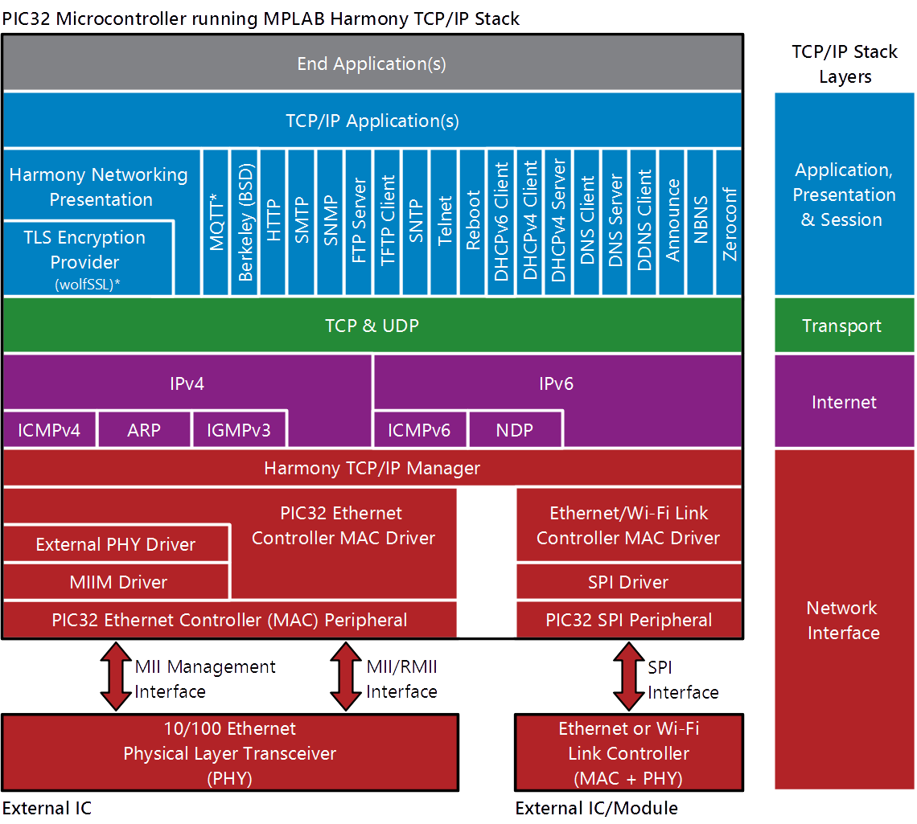
Architecture
PIC32 and SAM Microcontrollers
Ethernet Network
Interface
WiFi Network
Interface

Slide 29
Application Layer
PIC32 MCU running MPLAB® Harmony TCP/IP Stack

Slide 30
Application Layer
Networking Applications can consist of:
User implemented TCP/UDP Socket Applications.
Prewritten MPLAB® Harmony TCP/IP Application Modules (e.g. HTTP) .
Multiple Networking Applications can run simultaneously.
TCP/IP Stack can coincide with other MPLAB® Harmony Middleware (e.g. Graphics).
Notes:
(cooperative multitasking with roundrobin scheduling.

Slide 31
Services and Applications
PIC32 MCU running MPLAB® Harmony TCP/IP Stack

Slide 32
Supported Services
DHCP: Dynamic Host Configuration Protocol
Used for IP Address Assignment
Server and Client Support
DNS: Domain Name System
Translates website name to IP Address
Server and Client Support
DDNS Client
Discovery and registration of public IP address with a DDNS Provider on the internet.
Notes:
TCPIP_DNSS_AddressCntGet
Get DNS Server IPv4 or IPv4 Address count details for the Input value of Index
TCPIP_DNSS_CacheEntryRemove
Remove DNS server cache entry by Hostname and IP Type and IP(v4 or v6) address
TCPIP_DNSS_Disable
Disables the DNS Server for the specified interface.
TCPIP_DNSS_Enable
Enables the DNS server for the specified interface.
TCPIP_DNSS_EntryAdd
Add a IPv4 or IPv6 entry to the DNS server table.
TCPIP_DNSS_IsEnabled
Determines if the DNS Server is enabled on the specified interface.
TCPIP_DNSS_EntryGet
Get DNS server IP address details from resolver pool entry.
TCPIP_DNSS_Task
Standard TCP/IP stack module task function.

Slide 33
Supported Services
Announce
Microchip TCP/IP Discovery Protocol used for identifying devices on a local network.
NBNS: NetBIOS Name Service
Translates local host names to IP Addresses
Zeroconf (Bonjour/Avahi)
A set of technologies to automatically create a usable network including IP Address assignment, distribution and resolution of hostnames, location of network services.
Notes:
In computer networking, the multicast Domain Name System (mDNS) resolves host names to IP addresses within small networks that do not include a local name server. It is a zero-configuration service, using essentially the same programming interfaces, packet formats and operating semantics as the unicast Domain Name System (DNS). Although Stuart Cheshire designed mDNS to be stand-alone capable, it can work in concert with unicast DNS servers.^{[1]}
The mDNS protocol is published as RFC 6762, uses IP multicast User Datagram Protocol (UDP) packets, and is implemented by the Apple Bonjour and Linux nss-mdns services.
mDNS can work in conjunction with DNS Service Discovery (DNS-SD), a companion zero-configuration technique specified separately in RFC 6763.^{[2]}
When an mDNS client needs to resolve a host name, it sends an IP multicast query message that asks the host having that name to identify itself. That target machine then multicasts a message that includes its IP address. All machines in that subnet can then use that information to update their mDNS caches.
Any host can relinquish its claim to a domain name by sending a response packet with a time to live (TTL) equal to zero.
By default, mDNS only and exclusively resolves host names ending with the .local top-level domain (TLD). This can cause problems if that domain includes hosts which do not implement mDNS but which can be found via a conventional unicast DNS server. Resolving such conflicts requires network-configuration changes that violate the zero-configuration goal.

Slide 34
Supported Services
MQTT: Message Queue Telemetry Transport
Machine-to-machine (M2M) or "Internet of Things" connectivity protocol
Lightweight publish/subscribe messaging transport
Supported with third party wolfMQTT which is bundled with MPLAB® Harmony.
https://www.wolfssl.com/wolfSSL/Products-wolfmqtt.html

Slide 35
Supported Applications
HTTP: Hypertext Transfer Protocol (Web Server)
Allows for serving of Webpages
Webpages can be stored in Program Memory, SD Card, or External Flash
Supports Forms and Dynamic Variables

Slide 36
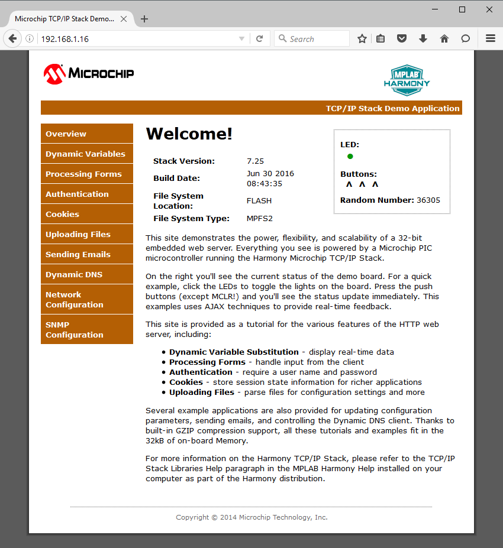
HTTP Web Server

Slide 37
Supported Applications
SMTP Simple Mail Transfer Protocol
Allows E-Mails to be sent.
Client Support
SNMP Simple Network Management Protocol
Allows for management of devices on a network.
FTP File Transfer Protocol
Allows for transfer of files.
NTP Network Time Protocol
Allows the time of day to be obtained from a precise timer server on the internet.

Slide 38
Encryption Provider
PIC32 MCU running MPLAB® Harmony TCP/IP Stack

Slide 39

Encryption Provider
TLS from wolfSSL (3rd party provider)
Written in ANSI C
Works with or without RTOS
TLS 1.2 and DTLS 1.2
Integrates directly into MPLAB® Harmony TCP/IP Stack
Distributed with MPLAB Harmony
Can be evaluated free of charge
Requires a commercial license purchase for production
SSL= Secure Sockets Layer, TLS = Transport Layer Security
Notes:
wolfSSL’s CyaSSL Embedded SSL Library is not based on the OpenSLL cryptography library and therefore was not impacted by the Heartbleed virus. wolfSLL is here at Masters. See them for pricing details.
Microchip’s Embedded SLL Library is also not based on OpenSLL. This library does not support TLS and is therefore not recommended if security is important. To comply with US Export Control restrictions, the encryption portion of the SSL module must be purchased separately from Microchip. The library of Data Encryption Routines (SW300052) is available for a nominal fee from microchipDIRECT.
SSL (Secure Sockets Layer) v3.0 encrypts data using a shared key between network hosts. It is the predecessor to TLS and was first released in 1996.
TLS (Transport Layer Security) is based on SSL. Makes it harder for “man-in-the-middle” (MITM) attacks.

Slide 40
Transport Layer
PIC32 MCU running MPLAB® Harmony TCP/IP Stack

Slide 41
Transport Layer
Light-weight and high-performance implementations of the TCP and UDP transport layers.
Various TCP and UDP configuration options are available at both project generation and run time (eg TX/RX buffer sizes).
Simultaneous sockets are supported (max number is configurable).
Simple APIs are used to create socket, check connection status, check TX/RX buffer status, read/write data, and close the socket.
Notes:
The transport layer uses sockets, which can either be TCP or UDP. Sockets require memory resources for storing buffers used for transmission and reception of data on the socket. Each socket used in the application requires its own buffer. The Harmony TCP/IP Stack will automatically manage memory allocation for sockets. By default, 1024 Bytes is allocated for each TCP Socket, with 512 bytes allocated to the TX Buffer and 512 bytes allocated to the TCP RX Buffer. The buffer sizes can be configured on a global basis, or on a per socket basis.
The Harmony TCPIP stacks supports the simultaneous operation of multiple TCP and UDP sockets. The total number of sockets it limited to 10 TCP, and 10 UDP by default, but this can be increased using the Harmony Configurator tool. Ultimately the maximum number of sockets is limited to the available RAM on the host microcontroller.
Sockets are created and managed using the Harmony Application Programming Interfaces (APIs). Both server and client sockets are supported. The APIs will be detailed later on in the class.

Slide 42
Internet Layer
PIC32 MCU running MPLAB® Harmony TCP/IP Stack

Slide 43
Internet Layer
IPv4 and IPv6 Support
Both IPv4 and IPv6 can run simultaneously
The IP Layer is transparent to all applications that use the built in Transport Layer functions.
IP Datagrams can be sent directly using a special API bypassing higher layer protocols.
Notes:
Volume IV: MPLAB Harmony Framework Reference > TCP/IP Stack Libraries Help > IPv4 Module > Using the Library > How the Library Works
On the transmit side, the IP layer_is responsible for routing and forwarding the IP datagrams to the required destination host. To do that, the IP layer_has internal functionality that allows the selection of the proper network interface and destination hardware address of a packet.
Based on the destination of a packet/datagram, the IP layer_will send the packet to either a host on the network or to a gateway if either is available. To accomplish this, the IP module works closely with the ARP layer_from which it requests the destination hardware addresses for outgoing packets. If the destination address of a packet is not known, the IP module will request an ARP probe and will wait for the ARP module reply. Whenever ARP signals that the solicited address is available, the IP module will send the packet over the network. If a time-out is reported (no such host could be found on that particular network), the packet is silently discarded.
On the receive side, the IP module processes all the incoming IPv4 packets and performs a basic sanity check of the packet checksum and other attributes. If the packet check fails, the packet is simply discarded. Otherwise, it is dispatched for further processing to the appropriate module (UDP, TCP, ICMP, etc.).
The IP layer_operation within the TCP/IP stack is transparent to the applications using the preferred_socket_API (MCHP UDP, TCP or BSD). This means that normally an application does not need to interface directly to the IP_layer. However, the IP module exposes an API that can be used by the application for sending IP datagrams directly, bypassing the normal higher layer_protocols (UDP, TCP).
Currently, it is not possible for an application to intercept the incoming IP datagrams and interfere with the default IP processing. However, this may change in the future and support can be added for the receive side.
For a detailed description of the IP layer_functionality, please consult RFC 791, RFC 1122, RFC 2474, etc.
This implementation does not support packet fragmentation (neither on transmit or receive).
To transmit an IP packet over the network, the application has to prepare an IPV4_PACKET data structure and properly format it so that the recipients of this packet (the IP and the MAC layers) can process the packet.
The TCP/IP Stack modules allocate the IPV4_PACKET data structures dynamically using the TCP/IP Stack private heap using packet allocation functions.
Currently, the packet and heap allocation functions are not exposed as public APIs as they are meant for stack’s private usage. This may change in the future.
The IPV4_PACKET packet can be allocated statically by the application.
When the IPV4_PACKET is constructed an important thing to remember is to fill in the appropriate packet acknowledge function. Once the MAC layer/driver is done with processing the packet (successfully or not) it will call the IPV4_PACKET acknowledge function, indicating that the packet is now available (and could be freed or reused).
The next step is to fill in the packet source and destination addresses, as well as the outgoing interface (please keep in mind that the TCP/IP stack supports multiple network interfaces).
This could be done with a call to TCPIP_IPV4_SelectSourceInterface or the application can select all these addresses manually.
All that’s left before handing the packet is to call TCPIP_IPV4_PacketFormatTx. This call fills in the supplied packet with the IP header structure and updates the IP checksum. Please note that this function expects a properly formatted packet, with the source and destination addresses filled in.
After this, the application can call TCPIP_IPV4_PacketTransmit. This function does some basic packet checks and expects that the packet has a valid network interface selected otherwise the call will fail.
After further formatting (with the MAC required headers), the IP layer_will try to send the packet over the network. If the destination hardware address is known (the ARP resolve call succeeds) the packet is handed over to the MAC. Otherwise, the IP will insert the packet into a queue, waiting for the ARP resolution. When ARP signals that the request is done (either success or timeout) the IP layer_intercepts the signal and removes the packet from the wait queue: either hands it over to the MAC for transmission or it discards it if the ARP resolution failed.
The MAC layer/driver in its turn can transmit it immediately, queue the packet for transmission or discard it (if, for example the network link is down). Regardless, once the packet is processed, the packet acknowledge function is called with an updated acknowledge result. This informs the owner of the packet about the result of the operation and also that the packet is no longer in traffic.
Transmission of chained packets is not supported. Each packet has to be transmitted individually.

Slide 44
IPv4 vs IPv6
192.168.1.1
IPv4
Four 8-bit segments
Decimal numbers 0 to 255
Number of addresses: 32 bits = 4.3 billion
IPv6
Eight 16-bit segments
Hex numbers 0 to FFFF
Number of addresses: 128 bits = 3.4x10³⁸
=340,282,366,920,938,463,463,374,607,431,768,211,456
FE80:0000:0000:0000:75EA:CEFF:FE44:5101

Slide 45
Network Interface Layer
PIC32 MCU running MPLAB® Harmony TCP/IP Stack

Slide 46
Network Interface Features
Multiple Concurrent Interfaces on one MCU e.g.
Ethernet + Wi-Fi®*
Ethernet + Ethernet
Drivers for supported interface devices are supplied in the TCP/IP stack.
Interface options are selected and configured using MPLAB® Harmony Configuration (MHC) Tool.
The TCP/IP Stack automatically initialises and manages the configured network interface(s).
*In Harmony 2.06, the Wi-Fi drivers can only support a single Wi-Fi interface.

Slide 47
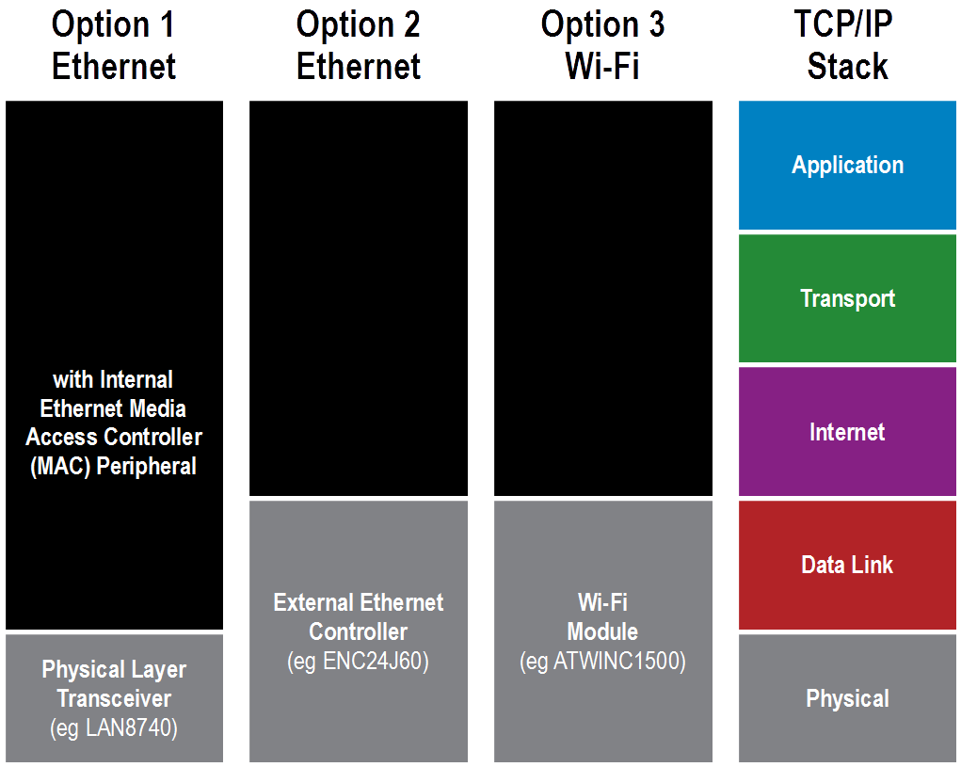


Network Interface Options
Notes:
Embedded Ethernet WiFi TCPIP Requirements
Hardware Interface to Network
Microcontroller running TCP/IP Protocol Stack
The Harmony TCPIP Stack supports both wired ethernet and wireless wifi networking. There are 3 primary hardware architectures that can be used to get the PIC32 onto a ethernet or wifi network.
Some PIC32 MX and MZ devices contain an integrated Ethernet Media Access Controller (MAC), which interfaces to a an external Physical Layer Transceiver (or PHY). This architecture offers the highest throughput. The MAC normally links to the PHY via an external RMII or MII interface. Microchip has a range of external PHY devices such as the LAN9500A.
For PIC32s without a MAC, an external Ethernet controller such as the Microchip ENC424J600 can be used, which provides MAC and PHY functions. Harmony presently supports an SPI interface between the PIC and ENC controller. This solution is typically more expensive than option 1, and has a slower throughput.
For wireless applications, the PIC32 is interfaced into the Microchip MRF24WG or WN WiFi Modules. The WiFi module provides the MAC and PHY Functions. The WiFi module is interfaced using SPI.
A forth option is where PIC32 is interfaced into the RN family of WiFi modules. The RN WiFi module already contains a TCP/IP Stack, hence the Harmony TCPIP Stack would not be used in this architecture.
The Harmony TCPIP Stack provides a full TCPIP Protocol Suite, including the Application Layer, Transport Layer, IP Layer, and the necessary drivers to interface the stack into MAC+PHY offersing.

Slide 48
Supported Interface Devices
Ethernet PHYs
Only used with PIC32 devices that have internal Ethernet MAC Peripheral
PHY Only: LAN8700, LAN8720, LAN8740, KSZ8041 & KSZ8061
PHY + Switch: LAN9303 & KSZ8863
Standalone Ethernet Link Controllers
ENC28J60 (SPI)
ENCx24J600 (SPI)
Wi-Fi®
ATWINC1500 (SPI)
ATWILC1000 (SPI)
Notes:
From the software point of view the MAC driver exposes an API that’s focused on efficient data transfer routines. Control of the driver and access to the transferred data is given by using regular driver client access functions.
Please note that the MAC model described here corresponds to a virtual MAC driver that the TCP/IP stack uses. All the implementations of the physical MAC drivers (Ethernet, Wi-Fi, etc.) must adhere and implement this API required by the virtual MAC API. This is how the TCP/IP stack achieves virtualization of the operation over multiple network interfaces. The TCP/IP stack makes no assumption about the specifics of an actual implementation and behaves all MACs to behave identically

Slide 49
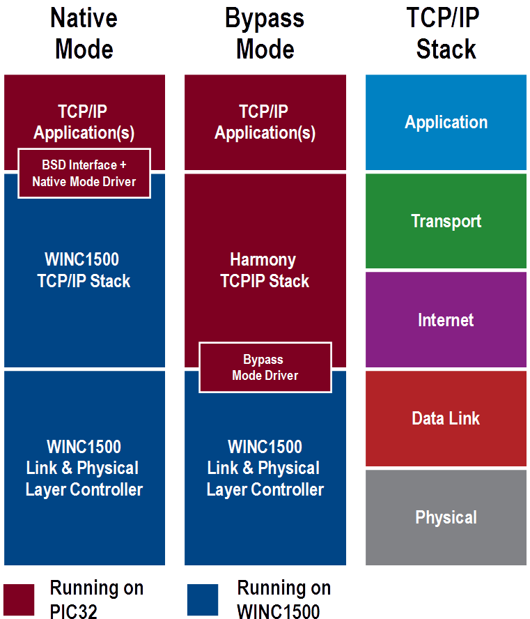
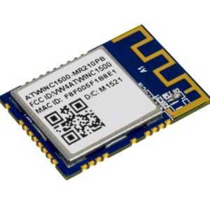
WINC1500 Wi-Fi® Module Operation Modes with Harmony
Two modes of operation:
Native Mode: TCP/IP Stack residing on WINC1500 device is utilised
Bypass Mode: Harmony TCP/IP Stack is utilised
Harmony TCP/IP Stack features are only available when WINC1500 is operated in Bypass mode.

Slide 50
MAC Address
All network interface devices must have a globally unique MAC address.
Some devices are already supplied with a MAC Address, including:
PIC32 devices with Internal Ethernet MAC Peripheral
All Microchip Wi-Fi® modules
Microchip ENCx24J600 Ethernet Controller

Slide 51
PIC32 MAC Address
A globally unique MAC Address is programmed into a read only section of Flash Program Memory.
This feature is only available on PIC32 Devices with an Internal Ethernet MAC Peripheral.
The address is automatically loaded into the EMAC1Sx registers after reset.
The address can be manually read using a Harmony API: PLIB_ETH_MACGetAddress.

Slide 52
TCP/IP Stack Features
Fully dynamic:
Stack initialization/de-initialization
Interface up/down
Resource management
Module configuration
Run-time configuration via APIs or Console
Interrupt driven operation
RTOS compatible
Notes:
The MPLAB Harmony TCP/IP Stack is designed as a part of a system running other applications, middleware, etc. Therefore, it
makes use of the system services that are available to other modules in the system or to the application, such as:
• File system
• System interrupts
• System driver services
• System timers
• System device drivers
• System command processor
• System console
• System debug services
Refer to the ./framework/tcpip/src/system folder for the header files that expose the system wide available API.

Slide 53
TCP/IP Console
Network specific commands:
Network info
Stack and interfaces up/down control
Whole stack or one interface at a time
IP addresses set/get
DHCP, NetBIOS names, etc.
Wi-Fi® commands included
TCP/IP Heap statistics
Socket Debugging
Notes:
Show a diagram on which services are interfaced into the Harmony TCPIP Console

Slide 54
Part 3: Using the MPLAB® Harmony TCP/IP Stack
Open an example project
Stack (Re)Configuration
Connectivity Check
MPLAB® Harmony TCP/IP Stack APIs
Tools

Slide 55

Harmony V3
Device Configuration
Peripheral Libraries
Initialize Device
Clocks
Pins
Memory
Vectors
Startup Code
Essentials…
Drivers & Services
Use Peripherals
Custom Initialization
Clean & direct
MCC-Like
Low overhead
Custom generated
Powerful Middleware
Share Resources & Peripherals
Built on PLIBs
Interoperable
Simple interfaces
Advanced capabilities
Real-Time OS
Add MW Stacks
Graphics
TCP/IP Networking
USB Host & Device
Cryptography
More…
Optimize CPU Usage
FreeRTOS Included
OS Abstraction Layer (OSAL)
Preemptive scheduling
Task prioritization
More…
I don´t care about libraries.
Just get the MCU initialized!
Give me a total system solution!
Notes:
MPLAB Harmony 3 natively supports applications ranging from basic device-configuration and peripheral-library based projects, to complex middleware and RTOS-based applications in order to help the developer scale projects up or down in complexity and capability without requiring extensive rewriting of existing code that is common in an embedded environment.

Slide 56





Harmony V3
MPLAB Harmony V3 on GitHub
BitBucket
(MCHP Private Git Server)
GitHub (Public Git Server)
MHCP Content
Community Content
Harmony Development
Customer Development
GFX
USB
TCP/IP
Core Drivers
Firewall
TCP/IP
USB
DRV1
DRV2
GFX
Core Drivers
Modular:
Individual libraries released when ready. No need to wait for complete Harmony release
Customer selects desired modules. No need to download everything.
Flexible:
Ability to quickly add/modify project configuration to meet evolving customer needs
Open:
Facilitates community content. Customer can select desired content with package manager.

Slide 57
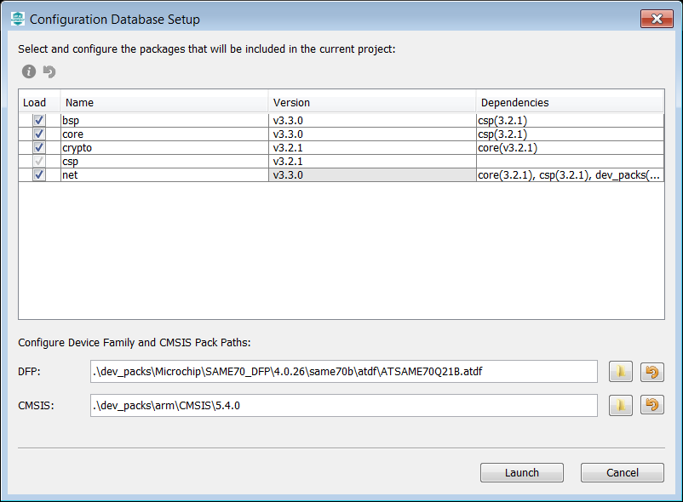
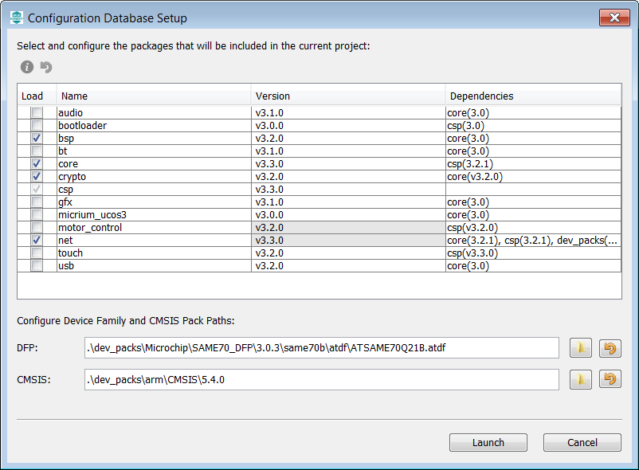
MHC Git

Slide 58
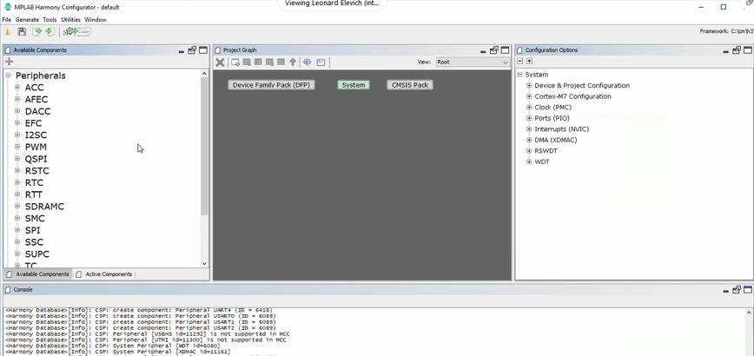
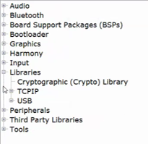
Harmony V3
MPLAB Harmony Configurator
Available Components
(Peripherals, Libraries,..)
Project Graph
Configuration Options

Slide 59
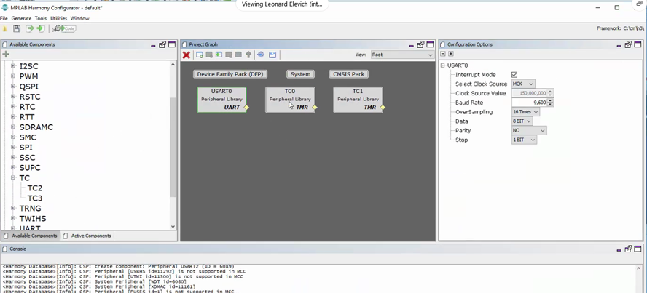
Harmony V3
MPLAB Harmony Configurator

Slide 60
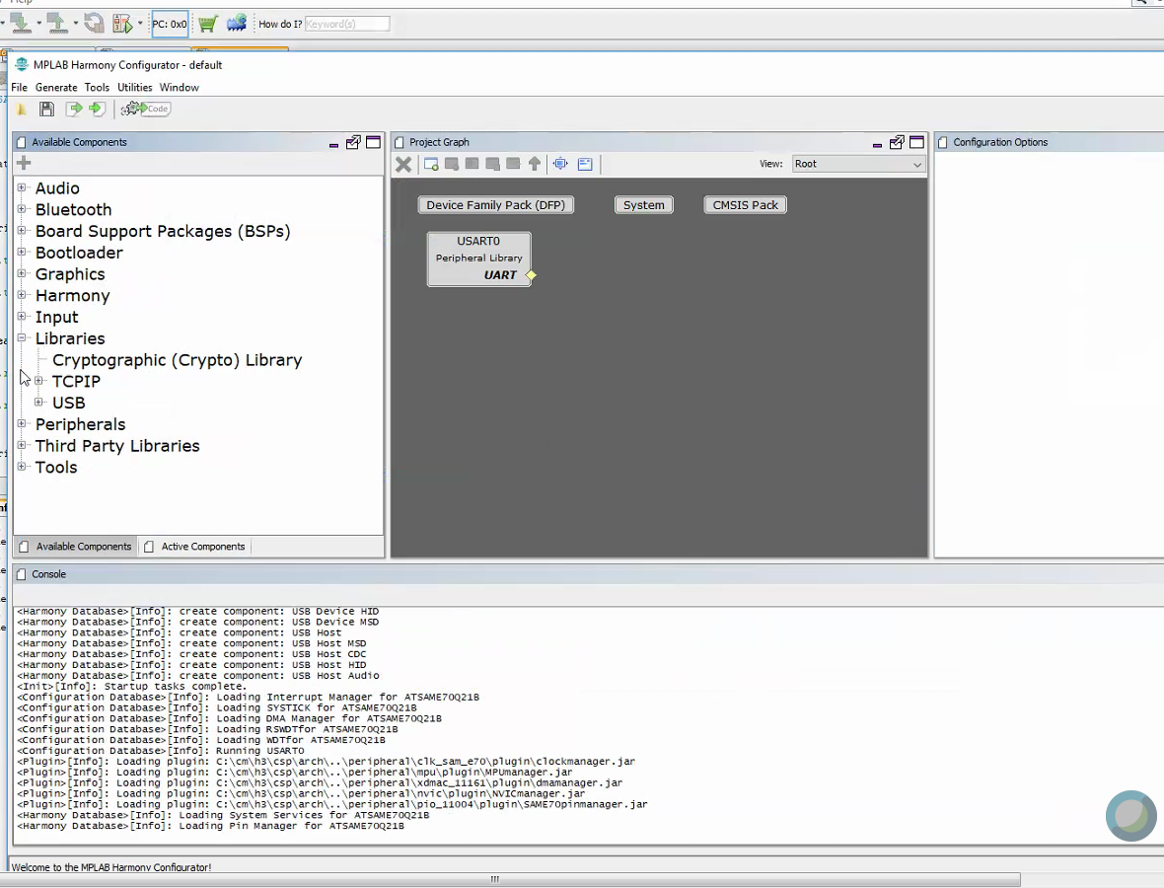
Harmony V3
Peripheral initialization only. No Driver!
Access completely managed from end-user
MPLAB Harmony Configurator

Slide 61
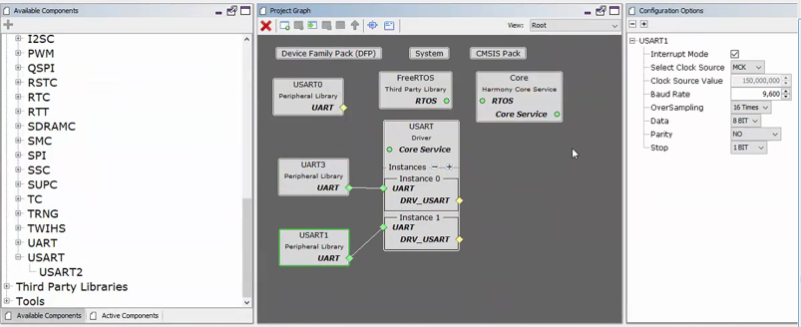
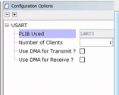
Harmony V3
Peripheral initialization only. No Driver!
Access completely managed from end-user
MPLAB Harmony Configurator
Complex driver to manage access to multiple UARTs
Peripheral initialization only.

Slide 62
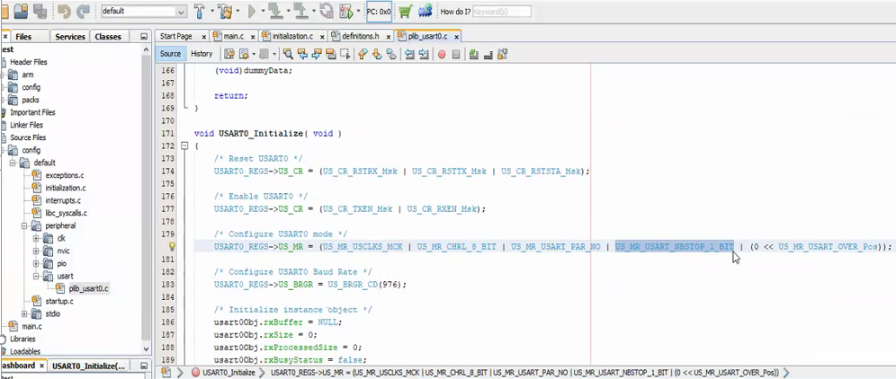
Harmony V3

Slide 63

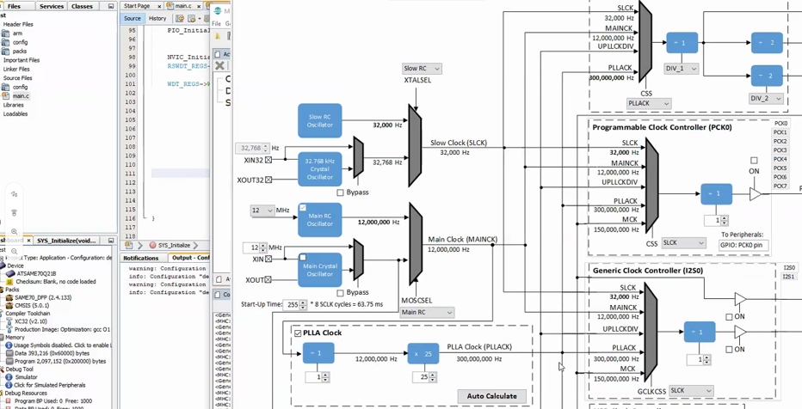
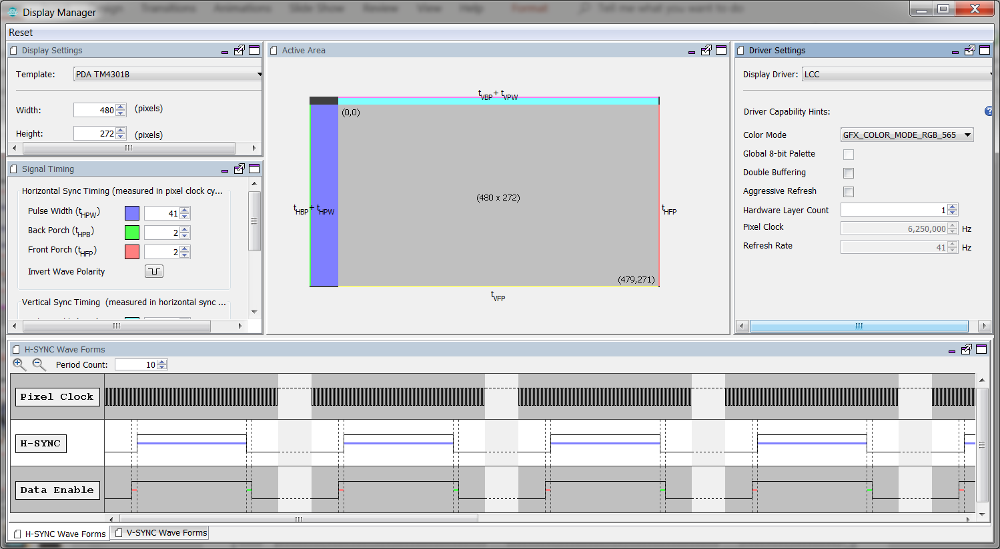
Harmony V3
Keep + improve the good things from Harmony V2
Clock Initialization
Pinout/I/O Management
Graphic
TCP/IP and SSL1.3
Security
USB
Audio
…

Slide 64
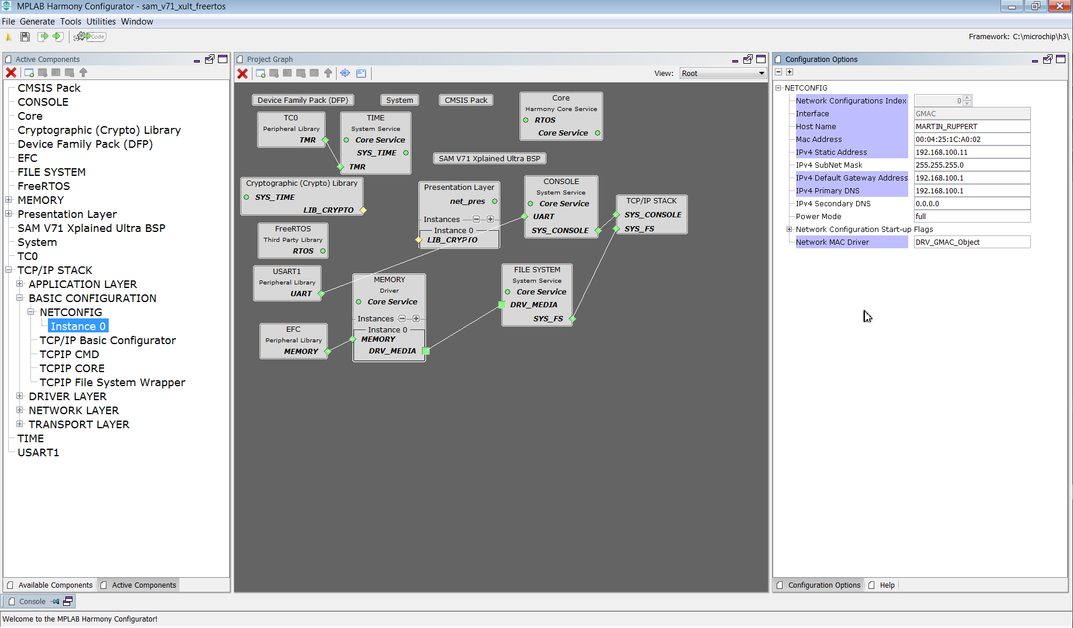
MHC

Slide 65
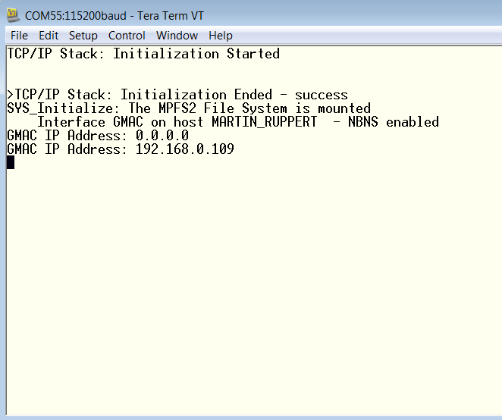
Terminal

Slide 66
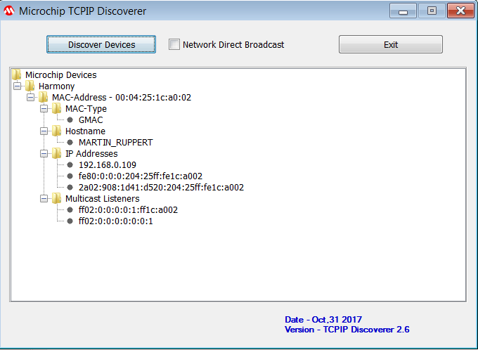
TCPIP Discoverer

Slide 67
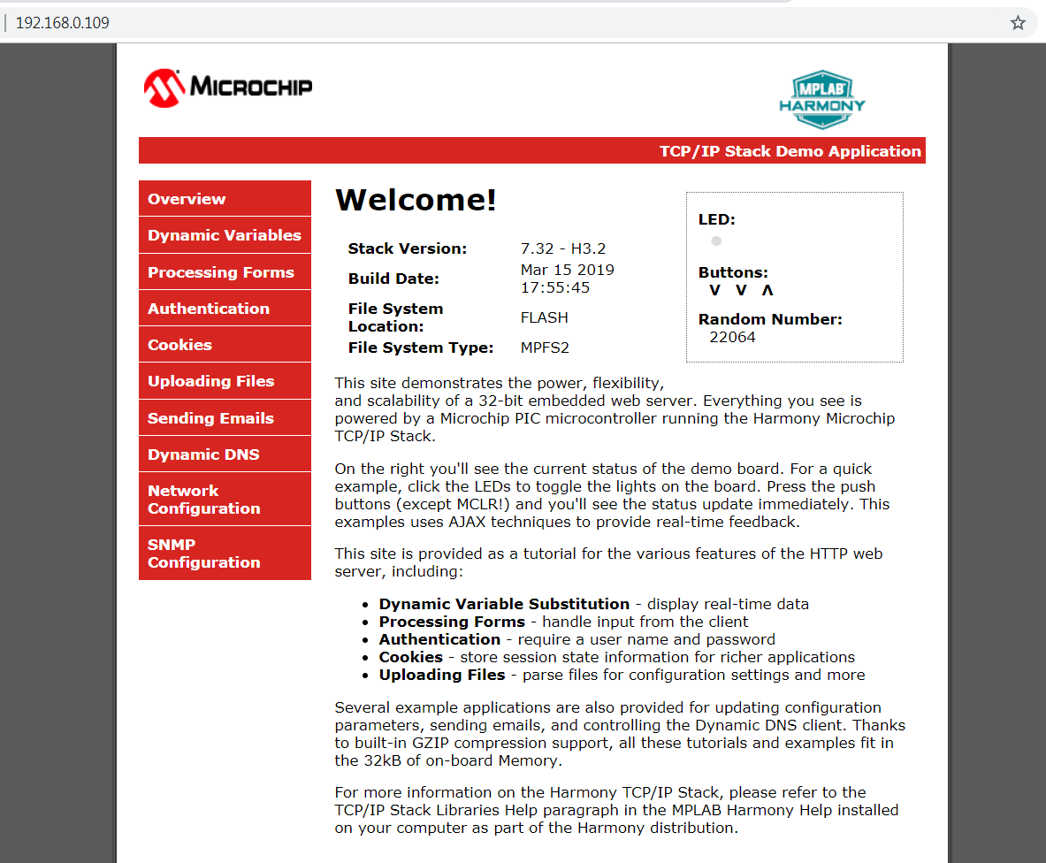
HTTP2 Webserver

Slide 68
Using RTOS with MPLAB Harmony

Slide 69
Why use RTOS?
Priority based task scheduling
Ensures better responsiveness to events
A pre-emptive scheduler always runs the highest priority task that is ready to run, allowing hard real time tasks to meet its deadlines
Removes dependency of tasks on the execution time of other functions running in the “super loop”
Efficient CPU usage
Does not waste CPU cycles by running tasks waiting on events/ resources
Idle task is run when there are no application tasks ready to run. This allows putting CPU in low power modes
Notes:
In a sequential or "big-loop" program, other than interrupt handling, events are processed when the program "gets around to it", the cycle time may be non-deterministic and may vary as functions are added, removed and changed. So the performance and responsiveness of your system is dependent upon every change you make to the code, and the behaviour and ability to meet timing deadlines can be affected by changes unrelated to the function that ultimately fails.
By using pre-emptive priority based scheduling an RTOS can respond deterministically to events so changes in processing time of one task need not affect other tasks of higher priority.
Beyond the deterministic response, the ability to separate functionality into threads of execution, makes each of these threads simpler and less co-dependent. Instead of one "big loop" handling everything, you have many independent specialist loops that are easier to test and develop and easier to add, remove and re-use to change the behaviour and functionality of your system.
Task scheduling – creates illusion that all tasks are running simultaneously

Slide 70
RTOS Driven
static void _SENSORTASK_Tasks(void)
{
while(1)
{
SENSORTASK_Tasks();
vTaskDelay(10); /*Give time back*/
}
}
Application
Middleware
void _SYS_Tasks (void *param)
{
while(1)
{
DRV_SPI_Tasks(sysObj.spiObjectIdx0);
vTaskDelay(10);/*Give time back*/
}
}
Driver
void SPI_ISR(void)
{
DRV_SPI_Tasks(sysObj.spiObjectIdx0);
}
PLIB
Notes:
This same sort of flexibility extends to RTOS support. In an RTOS environment, instead of having a single main loop, the configuration will have multiple “deamon” threads, each with its own loop. Most of the time, you will still want drivers to be interrupt driven. Interrupts usually support the best real-time response latency and hardware usually provides mechanisms for setting interrupt priorities. And, an RTOS usually provides the ability to prioritize the threads that would otherwise be polled. Show difference on OSAL calls
But, to support this, Microchip’s next generation libraries must be RTOS safe. That is made possible by the Operating System Abstraction Layer (OSAL).
In the coming slides, let us look at how harmony drivers are written for interrupt and thread safety. But before that let us see why it is necessary to safeguard interrupts and threads against simultaneous access.

Slide 71
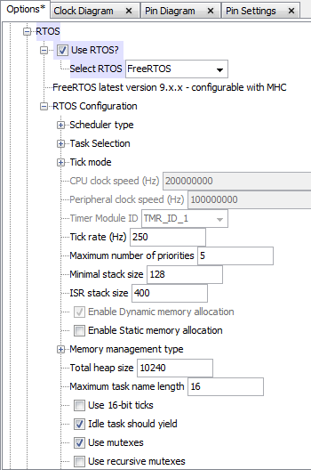
RTOS – MHC Configuration
Enable and Select desired RTOS
freeRTOS
openRTOS
uc/os-II
uc/os-III
Thread X
embOS
Enable and Configure RTOS specific options

Slide 72
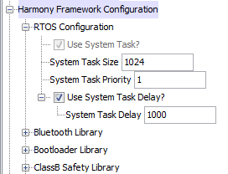
RTOS – MHC Configuration
RTOS configuration for the SYS_Tasks thread.
void SYS_Tasks ( void )
{
/* Create OS Thread for Sys Tasks. */
xTaskCreate((TaskFunction_t) _SYS_Tasks,
"Sys Tasks",
1024, NULL, 1, NULL);
…..
}
static void _SYS_Tasks ( void)
{
while(1)
{
/* Maintain system services */
SYS_CONSOLE_Tasks(sysObj.sysConsole0);
/* Maintain Device Drivers */
/* Maintain Middleware */
/* Task Delay */
vTaskDelay(1000 / portTICK_PERIOD_MS);
}
}
Block the task for 1000
milliseconds. Allows other tasks to run.

Slide 73
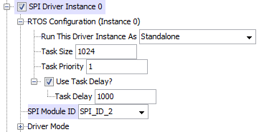
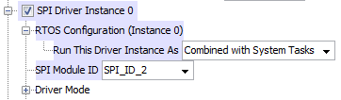
RTOS – MHC Configuration
RTOS configuration for a driver instance which is configured for polled mode operation
Standalone –Run the driver task as a separate RTOS thread
void SYS_Tasks ( void )
{
/* Create OS Thread for DRV_SPI Instance 0 Tasks. */
xTaskCreate((TaskFunction_t) _DRV_SPI_IDX0_Tasks,
"DRV_SPI Instance 0 Tasks",
1024, NULL, 1, NULL);
….
}
void _DRV_SPI_IDX0_Tasks(void)
{
while(1)
{
DRV_SPI_Tasks(sysObj.spiObjectIdx0);
vTaskDelay(1000 / portTICK_PERIOD_MS);
}
}
static void _SYS_Tasks ( void)
{
while(1)
{
/* Maintain system services */
SYS_CONSOLE_Tasks(sysObj.sysConsole0);
/* Maintain Device Drivers */
DRV_SPI_Tasks(sysObj.spiObjectIdx0);
/* Maintain Middleware */
/* Task Delay */
vTaskDelay(1000 / portTICK_PERIOD_MS);
}
}
Combined with System Tasks – Run the driver task as part of the _SYS_Tasks thread

Slide 74
System Initialization & Tasks
int main(void)
{
SYS_Initialize(NULL);
while(true)
{
SYS_Tasks();
}
return(EXIT_VALUE);
}
void SYS_Initialize( void* data )
{
SYS_CLK_Initialize( &clkInit );
BSP_Initialize();
sysObj.spiObjectIdx0 = DRV_SPI_Initialize (DRV_SPI_INDEX_0, &drvSpi0InitData);
sysObj.drvTmr0 = DRV_TMR_Initialize(DRV_TMR_INDEX_0, &drvTmr0InitData);
……
/*create Tasks*/
APP_Initialize();
}
void SYS_Tasks ( void )
{
/* Create OS Thread for Sys Tasks. */
xTaskCreate((TaskFunction_t) _SYS_Tasks, "Sys Tasks",1024, NULL, 3, NULL);
xTaskCreate((TaskFunction_t) _USB_Tasks, "USB Tasks",1024, NULL, 3, NULL);
/* Create OS Thread for SENSORTASK Tasks. */
xTaskCreate((TaskFunction_t) _SENSORTASK_Tasks, "SENSORTASK Tasks", 1024, NULL, 2, NULL);
/* Create OS Thread for EEPROMTASK Tasks. */
xTaskCreate((TaskFunction_t) _EEPROM_Tasks, “EEPROM Tasks", 1024, NULL, 1, NULL);
…….
/**************
* Start RTOS *
**************/
vTaskStartScheduler(); /* This function never returns. */
Notes:
This slide shows an example of what a simple system might look like. Notice the the consistent “main” function from before. The first thing “main” does is call “SYS_Initialize” to initialize the clock, the board (via BSP_Initialize()), all modules in the system (here, just the USART and timer drivers and a timer system service), and the application. Then, “main” drops into the system-wide “super loop”, repeatedly calling “SYS_Tasks” which in turn calls the “Tasks” functions for each module and the application. This keeps the system running and is part of a system configuration (so it can be different from configuration to configuration, which we will explore in more detail later).

Slide 75
The Hardware for this Class

Slide 76
SAME70

Slide 77
SAME70 Xplained Ultra

Slide 78
SAME70 Xplained Ultra

Slide 79
SAME70 Xplained Ultra

Slide 80
SAME70 Xplained Ultra

Slide 81
Now it is time for Lab1
A walk through an existing TCP Application,
adding some changes with
Microchip Harmony Configurator
And playing with the tools

Slide 82
BERKELEY MODULE
Using the MPLAB® Harmony TCP/IP Stack

Slide 83
Berkeley Socket
Berkeley sockets is an application programming interface (API) for Internet sockets and Unix domain sockets, used for inter-process communication (IPC). It is commonly implemented as a library of linkable modules. It originated with the 4.2BSD Unix operating system, released in 1983.
A socket is an abstract representation (handle) for the local endpoint of a network communication path. The Berkeley sockets API represents it as a file descriptor (file handle) in the Unix philosophy that provides a common interface for input and output to streams of data.

Slide 84
Berkeley APIs
API Name | Host | Description
socket | Server/Client | Creates a new BSD socket.
bind | Server | Assigns the local address of the communication endpoint.
connect | Client | Assigns the address of the peer communications endpoint, and establishes a connection between the end points.
listen | Server | Sets the specified socket in a listen mode and ready to accept connection requests.
accept | Server | Accept connection requests queued for a listening socket.
send | Server/Client | Send outgoing data on an already connected socket.
recv | Server/Client | Receive incoming data that has been queued for a socket.
closesocket | Server/Client | Closes an existing socket.

Slide 85
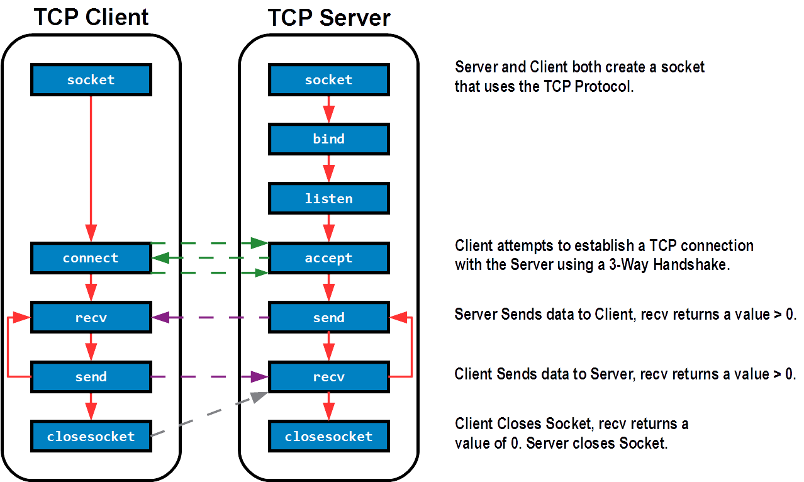
BSD Socket Application Flow

Slide 86
H3 Socket Application Flow

Slide 87
Tips
The Berkeley APIs available in the Harmony Framework can only operate in non-blocking mode.
TCP/IP Applications using Berkeley Module APIs should be implemented using a non-blocking state machine.
Example application source code can be found in the app.c file in the following Harmony TCP/IP Demonstration Projects:
berkeley_tcp_client
berkeley_tcp_server
berkeley_udp_client
berkeley_udp_server

Slide 88
Now it is time for Lab2
A complete Vending Machine
Service Application

Slide 89
LAB 2
Vending Machine
Libraries to establish communication between a TCP Client and Server
Dynamic variables and GET request from an HTTP client handled in Harmony HTTP server

Slide 90
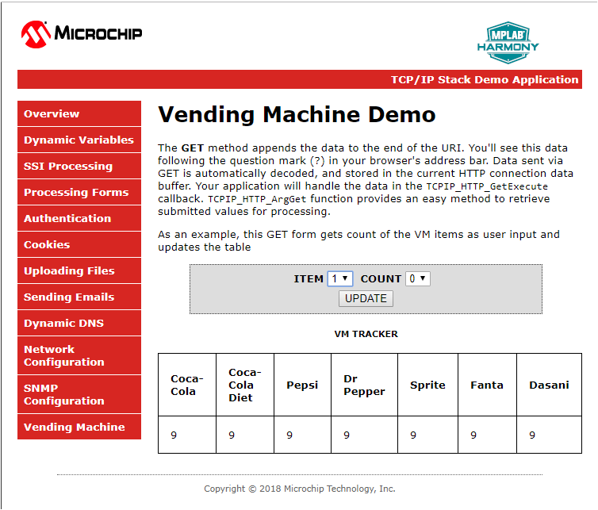
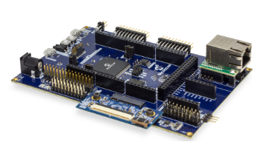
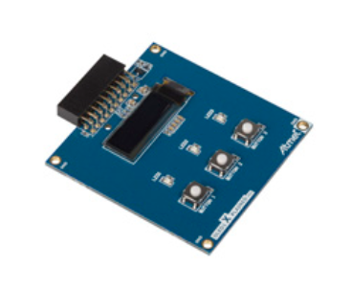
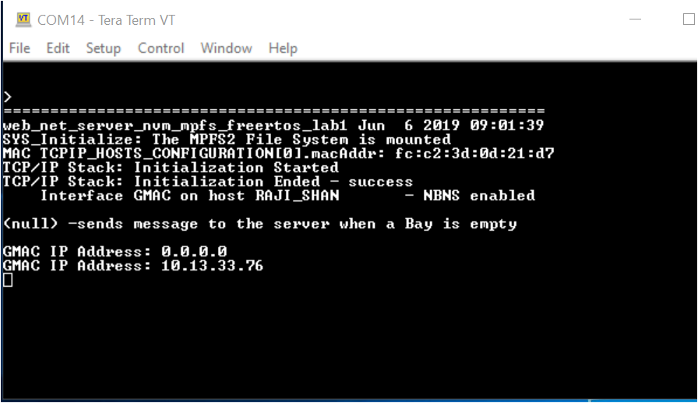
LAB 2- TASK 1
Hardware
SAM E70 Xplained Ultra Evaluation Kit
OLED1 Xplained Pro Extension Kit
E70 WEB SERVER
/Vending Machine

Slide 91
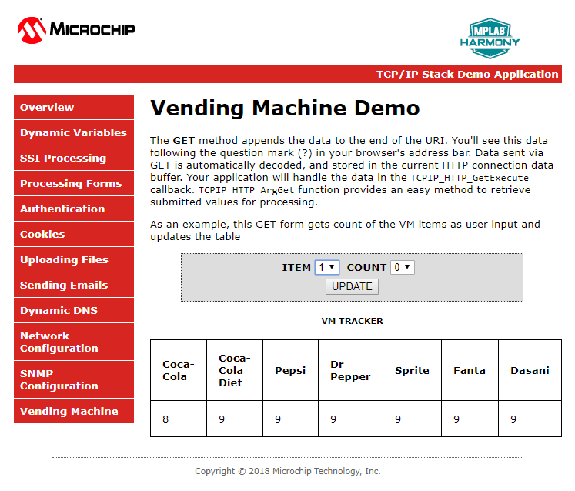
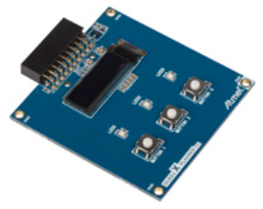
LAB2 –TASK1
Server updates the VM Client
VM Item Select Button
1.Coco-Cola
1.Coco-Cola
9
8

Slide 92
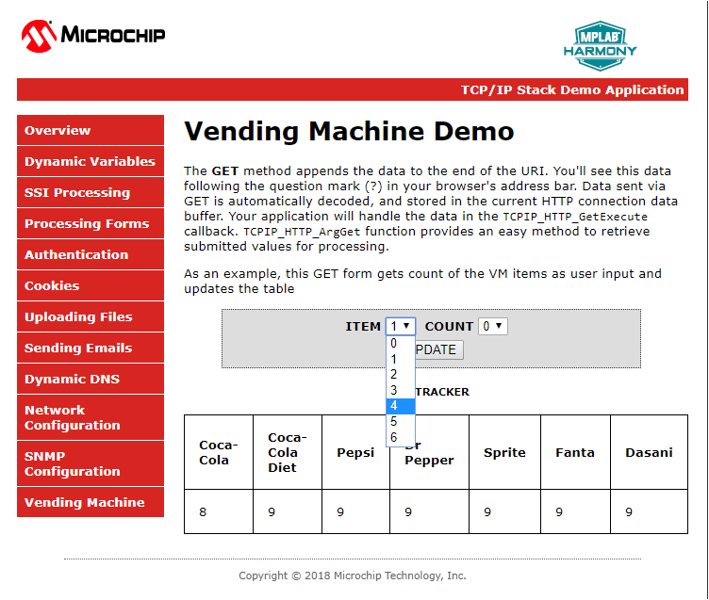
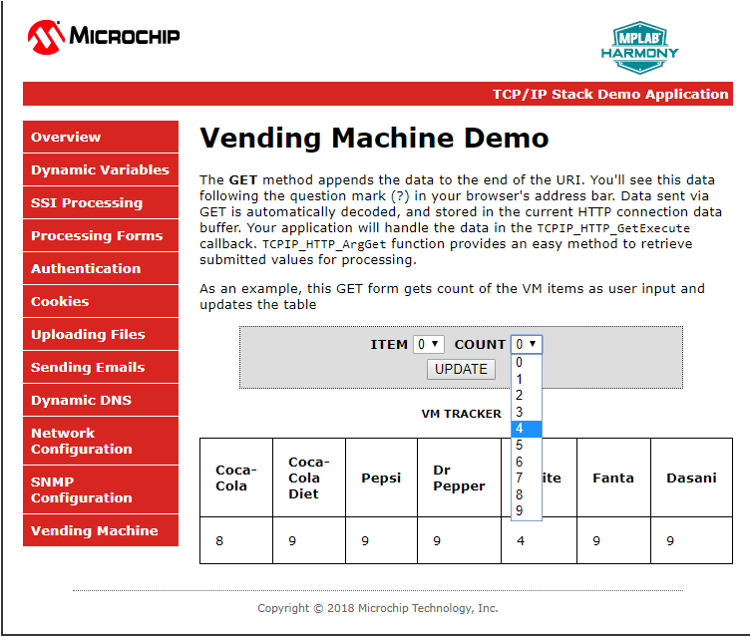
LAB 2 –Task 1
4
4. Dr Pepper

Slide 93
VM Server

Slide 94
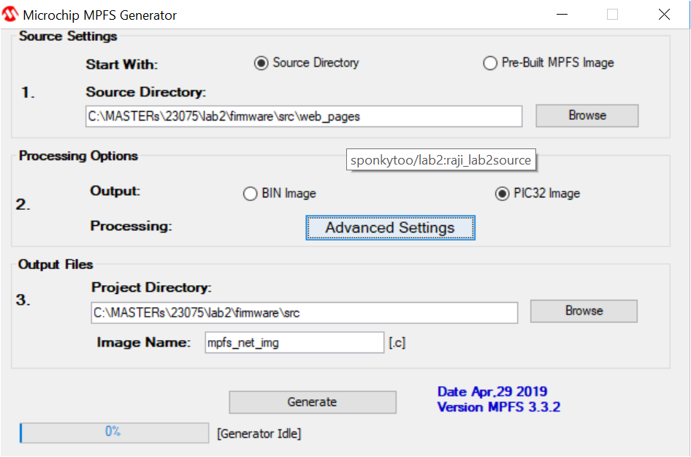
LAB 2 – MPFS Generator
Packages web pages into efficient storage format
Microchip MPFS Utility
Can include the utility on the build process

Slide 95
Using RTOS with MPLAB Harmony

Slide 96
Why use RTOS?
Priority based task scheduling
Ensures better responsiveness to events
A pre-emptive scheduler always runs the highest priority task that is ready to run, allowing hard real time tasks to meet its deadlines
Removes dependency of tasks on the execution time of other functions running in the “super loop”
Efficient CPU usage
Does not waste CPU cycles by running tasks waiting on events/ resources
Idle task is run when there are no application tasks ready to run. This allows putting CPU in low power modes
Notes:
In a sequential or "big-loop" program, other than interrupt handling, events are processed when the program "gets around to it", the cycle time may be non-deterministic and may vary as functions are added, removed and changed. So the performance and responsiveness of your system is dependent upon every change you make to the code, and the behaviour and ability to meet timing deadlines can be affected by changes unrelated to the function that ultimately fails.
By using pre-emptive priority based scheduling an RTOS can respond deterministically to events so changes in processing time of one task need not affect other tasks of higher priority.
Beyond the deterministic response, the ability to separate functionality into threads of execution, makes each of these threads simpler and less co-dependent. Instead of one "big loop" handling everything, you have many independent specialist loops that are easier to test and develop and easier to add, remove and re-use to change the behaviour and functionality of your system.
Task scheduling – creates illusion that all tasks are running simultaneously

Slide 97
RTOS Driven
static void _SENSORTASK_Tasks(void)
{
while(1)
{
SENSORTASK_Tasks();
vTaskDelay(10); /*Give time back*/
}
}
Application
Middleware
void _SYS_Tasks (void *param)
{
while(1)
{
DRV_SPI_Tasks(sysObj.spiObjectIdx0);
vTaskDelay(10);/*Give time back*/
}
}
Driver
void SPI_ISR(void)
{
DRV_SPI_Tasks(sysObj.spiObjectIdx0);
}
PLIB
Notes:
This same sort of flexibility extends to RTOS support. In an RTOS environment, instead of having a single main loop, the configuration will have multiple “deamon” threads, each with its own loop. Most of the time, you will still want drivers to be interrupt driven. Interrupts usually support the best real-time response latency and hardware usually provides mechanisms for setting interrupt priorities. And, an RTOS usually provides the ability to prioritize the threads that would otherwise be polled. Show difference on OSAL calls
But, to support this, Microchip’s next generation libraries must be RTOS safe. That is made possible by the Operating System Abstraction Layer (OSAL).
In the coming slides, let us look at how harmony drivers are written for interrupt and thread safety. But before that let us see why it is necessary to safeguard interrupts and threads against simultaneous access.

Slide 98
RTOS – MHC Configuration
Enable and Select desired RTOS
freeRTOS
openRTOS
uc/os-II
uc/os-III
Thread X
embOS
Enable and Configure RTOS specific options

Slide 99
RTOS – MHC Configuration
RTOS configuration for the SYS_Tasks thread.
void SYS_Tasks ( void )
{
/* Create OS Thread for Sys Tasks. */
xTaskCreate((TaskFunction_t) _SYS_Tasks,
"Sys Tasks",
1024, NULL, 1, NULL);
…..
}
static void _SYS_Tasks ( void)
{
while(1)
{
/* Maintain system services */
SYS_CONSOLE_Tasks(sysObj.sysConsole0);
/* Maintain Device Drivers */
/* Maintain Middleware */
/* Task Delay */
vTaskDelay(1000 / portTICK_PERIOD_MS);
}
}
Block the task for 1000
milliseconds. Allows other tasks to run.

Slide 100
RTOS – MHC Configuration
RTOS configuration for a driver instance which is configured for polled mode operation
Standalone –Run the driver task as a separate RTOS thread
void SYS_Tasks ( void )
{
/* Create OS Thread for DRV_SPI Instance 0 Tasks. */
xTaskCreate((TaskFunction_t) _DRV_SPI_IDX0_Tasks,
"DRV_SPI Instance 0 Tasks",
1024, NULL, 1, NULL);
….
}
void _DRV_SPI_IDX0_Tasks(void)
{
while(1)
{
DRV_SPI_Tasks(sysObj.spiObjectIdx0);
vTaskDelay(1000 / portTICK_PERIOD_MS);
}
}
static void _SYS_Tasks ( void)
{
while(1)
{
/* Maintain system services */
SYS_CONSOLE_Tasks(sysObj.sysConsole0);
/* Maintain Device Drivers */
DRV_SPI_Tasks(sysObj.spiObjectIdx0);
/* Maintain Middleware */
/* Task Delay */
vTaskDelay(1000 / portTICK_PERIOD_MS);
}
}
Combined with System Tasks – Run the driver task as part of the _SYS_Tasks thread

Slide 101
System Initialization & Tasks
int main(void)
{
SYS_Initialize(NULL);
while(true)
{
SYS_Tasks();
}
return(EXIT_VALUE);
}
void SYS_Initialize( void* data )
{
SYS_CLK_Initialize( &clkInit );
BSP_Initialize();
sysObj.spiObjectIdx0 = DRV_SPI_Initialize (DRV_SPI_INDEX_0, &drvSpi0InitData);
sysObj.drvTmr0 = DRV_TMR_Initialize(DRV_TMR_INDEX_0, &drvTmr0InitData);
……
/*create Tasks*/
APP_Initialize();
}
void SYS_Tasks ( void )
{
/* Create OS Thread for Sys Tasks. */
xTaskCreate((TaskFunction_t) _SYS_Tasks, "Sys Tasks",1024, NULL, 3, NULL);
xTaskCreate((TaskFunction_t) _USB_Tasks, "USB Tasks",1024, NULL, 3, NULL);
/* Create OS Thread for SENSORTASK Tasks. */
xTaskCreate((TaskFunction_t) _SENSORTASK_Tasks, "SENSORTASK Tasks", 1024, NULL, 2, NULL);
/* Create OS Thread for EEPROMTASK Tasks. */
xTaskCreate((TaskFunction_t) _EEPROM_Tasks, “EEPROM Tasks", 1024, NULL, 1, NULL);
…….
/**************
* Start RTOS *
**************/
vTaskStartScheduler(); /* This function never returns. */
Notes:
This slide shows an example of what a simple system might look like. Notice the the consistent “main” function from before. The first thing “main” does is call “SYS_Initialize” to initialize the clock, the board (via BSP_Initialize()), all modules in the system (here, just the USART and timer drivers and a timer system service), and the application. Then, “main” drops into the system-wide “super loop”, repeatedly calling “SYS_Tasks” which in turn calls the “Tasks” functions for each module and the application. This keeps the system running and is part of a system configuration (so it can be different from configuration to configuration, which we will explore in more detail later).

Slide 102
Data Protocol
Data exchanged through a TCP/UDP Socket can use a custom protocol or a standard protocol such as HTTP or MQTT.
Data can be formatted using a standard data-interchange format such as JSON or XML.

Slide 103
Data Protocol Examples
Example Sensor Data: “ID: AZ2355, Temperature: 25C, Time: 08:56, Type: K Thermocouple”
Custom Protocol <AZ2355|25C|08:56|KTC> | Custom over HTTP POST/sensorData/temperature.html HTTP/1.0User-Agent: HTTPTool/1.0Content-Type: application/x-www-form-urlencodedContent-Length: 23 <AZ2355|25C|08:56|KTC> | JSON { "sensor": { "id": "AZ2355", "type": "kthermocouple" }, "readings": [ { "time": "08:56", "temperature": 25, "unit": "C" } ] } | XML <?xml version="1.0" encoding="UTF-8"?> <root> <readings> <element> <temperature>25</temperature> <time>08:56</time> <unit>C</unit> </element> </readings> <sensor> <id>az2355</id> <type>kthermocouple</type> </sensor> </root>
Notes:
Data exchanged in a TCP Socket between a server and client can use a custom protocol, or a standard protocol such as HTTP. User data could be formatted using a structure such as JSON or XML.

Slide 104
Now it is time for Lab3
Getting the Weather Report

Slide 105
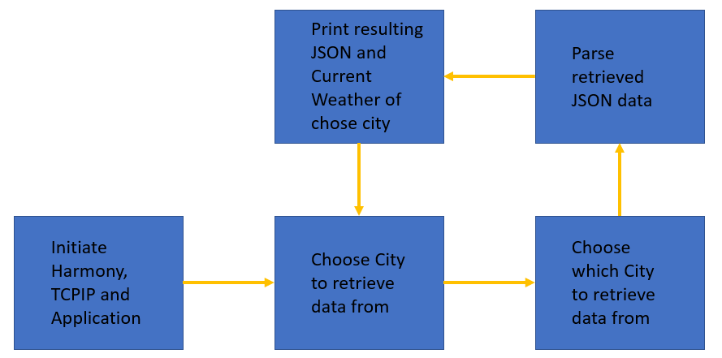
Pulling the Weather Data

Slide 106
Pulling the Weather Data

Slide 107
A TCP programmer without a Traffic Analyzer Tool is like a Electronic Developer without an Oscilloscope: He or she is then Blind

Slide 108
How to Analyze the Traffic
Rest of
the Universe
Managed Switch
1
2
3
4
5
6
7
8
Personal Computer

Slide 109
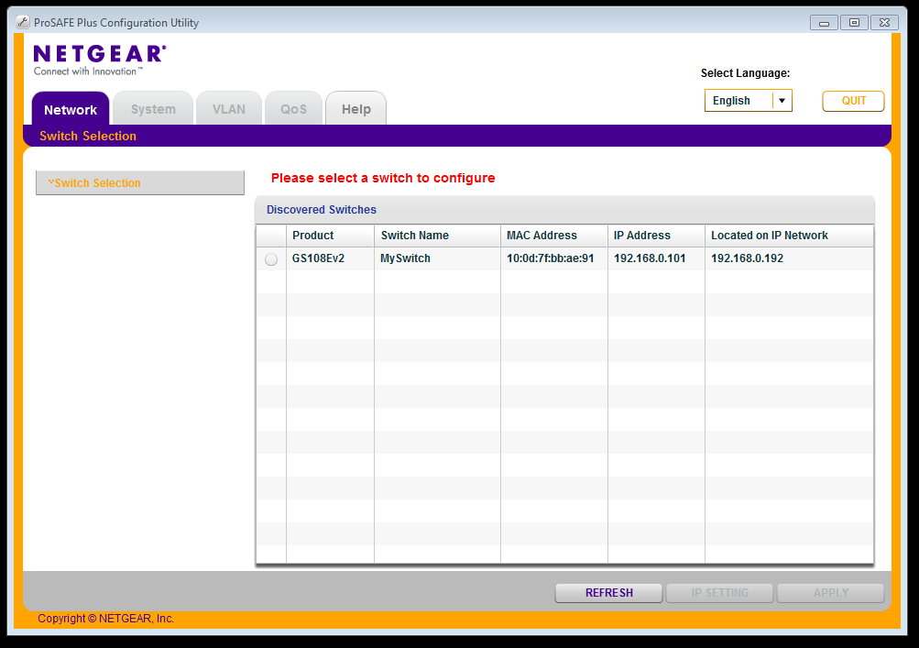
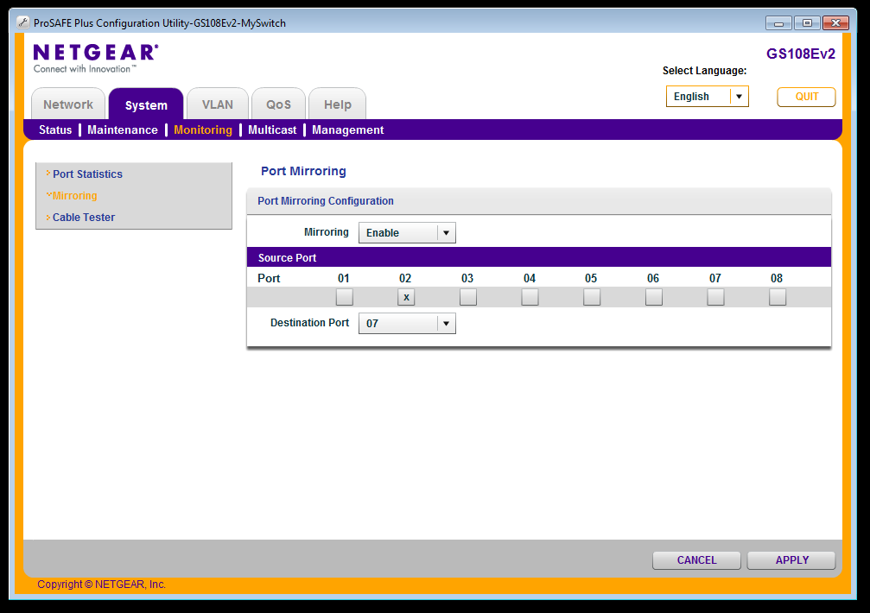
Configuration Software for Managed Switch
Microchip confidential – tentative

Slide 110
Wireshark Filter
eth.addr == fc:c2:3d:0c:20:44

Slide 111
Payload Data

Slide 112
Many thanks for attending this class
And...
...let us make this world a better place with TCPIP

Slide 113
LEGAL NOTICE
SOFTWARE:
You may use Microchip software exclusively with Microchip products. Further, use of Microchip software is subject to the copyright notices, disclaimers, and any license terms accompanying such software, whether set forth at the install of each program or posted in a header or text file.
Notwithstanding the above, certain components of software offered by Microchip and 3rd parties may be covered by “open source” software licenses – which include licenses that require that the distributor make the software available in source code format. To the extent required by such open source software licenses, the terms of such license will govern.
NOTICE & DISCLAIMER:
These materials and accompanying information (including, for example, any software, and references to 3rd party companies and 3rd party websites) are for informational purposes only and provided “AS IS.” Microchip assumes no responsibility for statements made by 3rd party companies, or materials or information that such 3rd parties may provide.
MICROCHIP DISCLAIMS ALL WARRANTIES, WHETHER EXPRESS, IMPLIED, OR STATUTORY, INCLUDING ANY IMPLIED WARRANTIES OF NONINFRINGEMENT, MERCHANTABILITY, AND FITNESS FOR A PARTICULAR PURPOSE. IN NO EVENT WILL MICROCHIP BE LIABLE FOR ANY DIRECT OR INDIRECT, SPECIAL, PUNITIVE, INCIDENTAL, OR CONSEQUENTIAL LOSS, DAMAGE, COST, OR EXPENSE OF ANY KIND RELATED TO THESE MATERIALS OR ACCOMPANYING INFORMATION PROVIDED TO YOU BY MICROCHIP OR OTHER THIRD PARTIES, EVEN IF MICROCHIP HAS BEEN ADVISED OF THE POSSIBLITY OF SUCH DAMAGES OR THE DAMAGES ARE FORESEEABLE. PLEASE BE AWARE THAT IMPLEMENTATION OF INTELLECTUAL PROPERTY PRESENTED HERE MAY REQUIRE A LICENSE FROM THIRD PARTIES.
TRADEMARKS:
The Microchip name and logo, the Microchip logo, Adaptec, AnyRate, AVR, AVR logo, AVR Freaks, BesTime, BitCloud, chipKIT, chipKIT logo, CryptoMemory, CryptoRF, dsPIC, FlashFlex, flexPWR, HELDO, IGLOO, JukeBlox, KeeLoq, Kleer, LANCheck, LinkMD, maXStylus, maXTouch, MediaLB, megaAVR, Microsemi, Microsemi logo, MOST, MOST logo, MPLAB, OptoLyzer, PackeTime, PIC, picoPower, PICSTART, PIC32 logo, PolarFire, Prochip Designer, QTouch, SAM-BA, SenGenuity, SpyNIC, SST, SST Logo, SuperFlash, Symmetricom, SyncServer, Tachyon, TempTrackr, TimeSource, tinyAVR, UNI/O, Vectron, and XMEGA are registered trademarks of Microchip Technology Incorporated in the U.S.A. and other countries.
APT, ClockWorks, The Embedded Control Solutions Company, EtherSynch, FlashTec, Hyper Speed Control, HyperLight Load, IntelliMOS, Libero, motorBench, mTouch, Powermite 3, Precision Edge, ProASIC, ProASIC Plus, ProASIC Plus logo, Quiet-Wire, SmartFusion, SyncWorld, Temux, TimeCesium, TimeHub, TimePictra, TimeProvider, Vite, WinPath, and ZL are registered trademarks of Microchip Technology Incorporated in the U.S.A.
Adjacent Key Suppression, AKS, Analog-for-the-Digital Age, Any Capacitor, AnyIn, AnyOut, BlueSky, BodyCom, CodeGuard, CryptoAuthentication, CryptoAutomotive, CryptoCompanion, CryptoController, dsPICDEM, dsPICDEM.net, Dynamic Average Matching, DAM, ECAN, EtherGREEN, In-Circuit Serial Programming, ICSP, INICnet, Inter-Chip Connectivity, JitterBlocker, KleerNet, KleerNet logo, memBrain, Mindi, MiWi, MPASM, MPF, MPLAB Certified logo, MPLIB, MPLINK, MultiTRAK, NetDetach, Omniscient Code Generation, PICDEM, PICDEM.net, PICkit, PICtail, PowerSmart, PureSilicon, QMatrix, REAL ICE, Ripple Blocker, SAM-ICE, Serial Quad I/O, SMART-I.S., SQI, SuperSwitcher, SuperSwitcher II, Total Endurance, TSHARC, USBCheck, VariSense, ViewSpan, WiperLock, Wireless DNA, and ZENA are trademarks of Microchip Technology Incorporated in the U.S.A. and other countries.
SQTP is a service mark of Microchip Technology Incorporated in the U.S.A.
The Adaptec logo, Frequency on Demand, Silicon Storage Technology, and Symmcom are registered trademarks of Microchip Technology Inc. in other countries.
GestIC is a registered trademark of Microchip Technology Germany II GmbH & Co. KG, a subsidiary of Microchip Technology Inc., in other countries.
All other trademarks mentioned herein are property of their respective companies.
© 2019, Microchip Technology Incorporated, All Rights Reserved.

